Slide 1
Connecting the jungle and other remote parts of the world
Chengyu Wang

Slide 2
TUCAN3G Project
An EU-funded project aimed to provide mobile technology and data services to the most remote and isolated areas in the world
Based on the femtocell technology

Slide 3
Why do we need this project ?
Costs to build classical access and backhaul infrastructures discourage the cellular companies
Low-income populations cannot afford the traditional cellular costs

Slide 4
Simple, cheap yet powerful
Utilize new wireless technology to create access networks based on 3G femtocells
Femtocells:
small, low-power cellular base stations that act as repeaters capable of boosting signals
work via solar energy
lower cost compared to a classical station

Slide 5
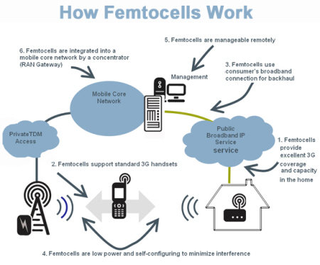

Slide 6
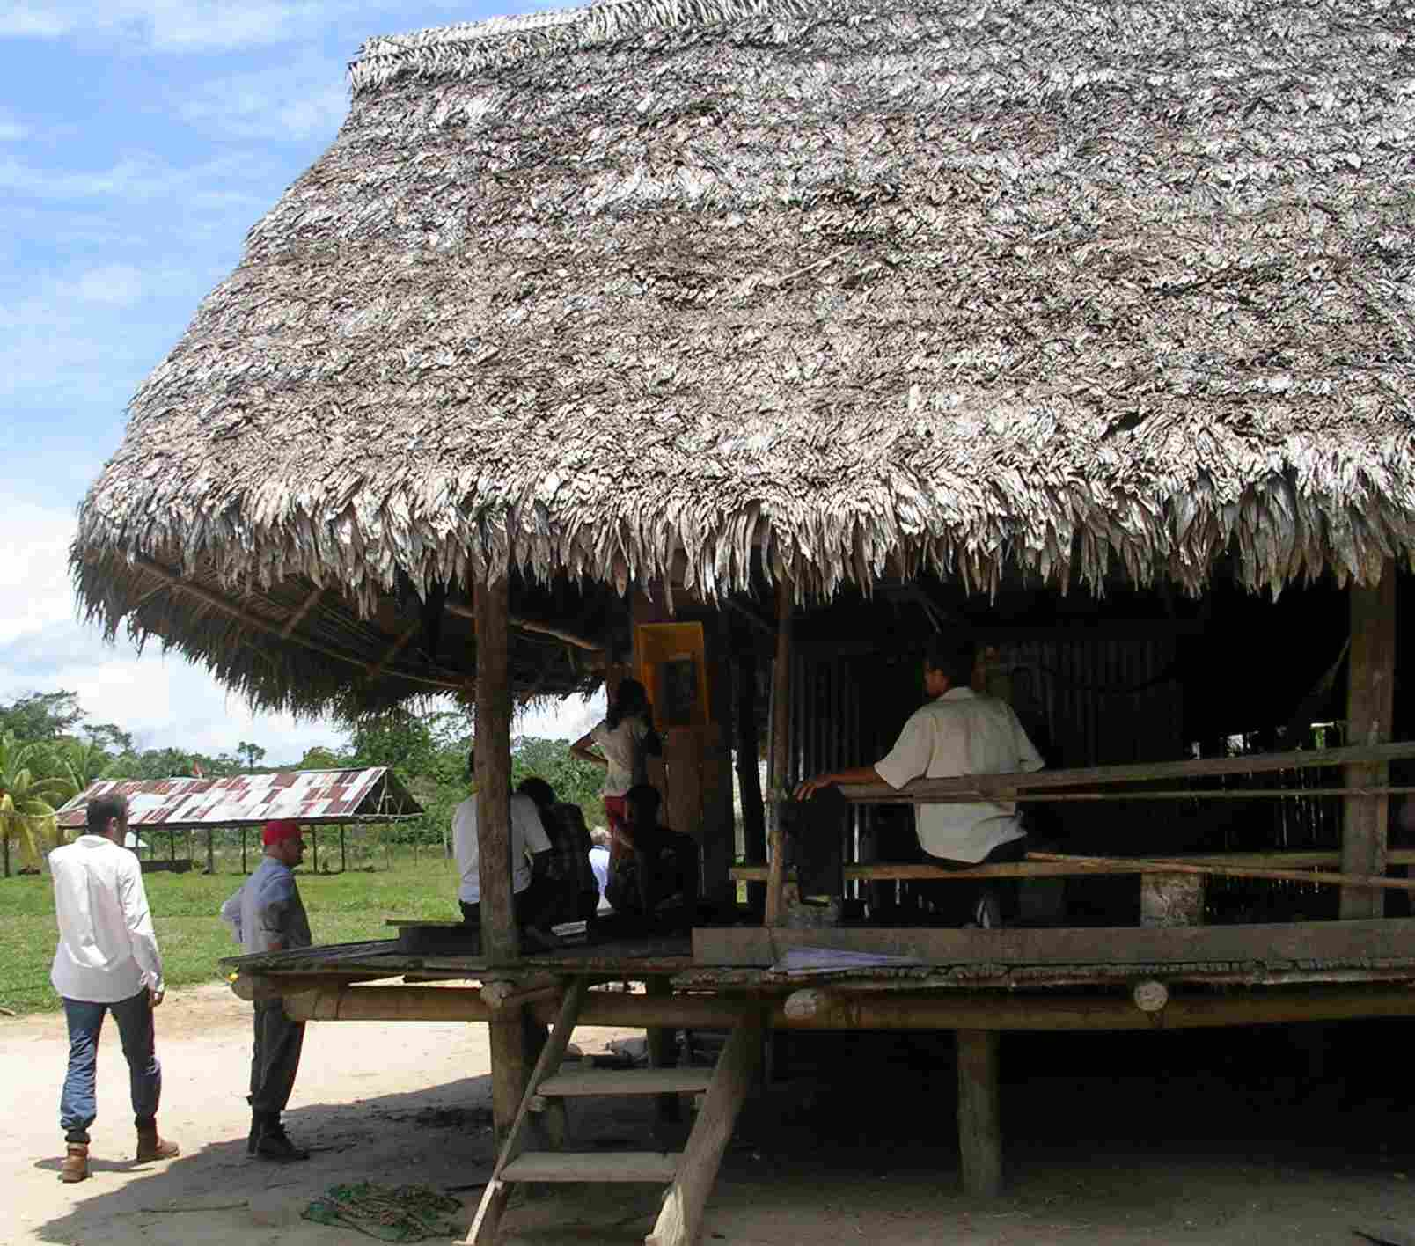
Demonstration platform
In a very remote part of Amazon rainforest
Install femtocells in six villages
Locals can communicate with relatives now

Slide 7
Toward universal connectivity
Development of small, mobile rural operators connected to the Telefonica backbone
A South American development bank has committed over EUR 700 000 towards expanding the program to another 15 villages
The potential is huge

Slide 8
Works cited
Community Research and Development Information Service - CORDIS. (n.d.). Retrieved December 01, 2016, from http://cordis.europa.eu/news/rcn/126192_en.html
TUCAN3G. (n.d.). Retrieved December 01, 2016, from http://www.ict-tucan3g.eu/

